Slide 1
Bandwidth Utilization (Part 2)
Course Code: COE 3201
Course Title: Data Communication
Dept. of Computer Engineering
Faculty of Engineering
Lecture No: | 10 | Week No: | 11 | Semester:
Lecturer:

Slide 2
Lecture Outline
Interleaving
Data rate management
Digital Hierarchy
T-lines & E-Lines

Slide 3
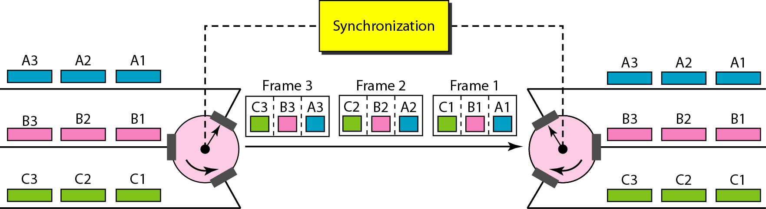
Interleaving
The process of taking a group of bits from each input line for multiplexing is called interleaving.
Interleaving is the process of multiplexing.
In TDM, synchronization between the sender and receiver is very important.
Fig. 17: Interleaving

Slide 4
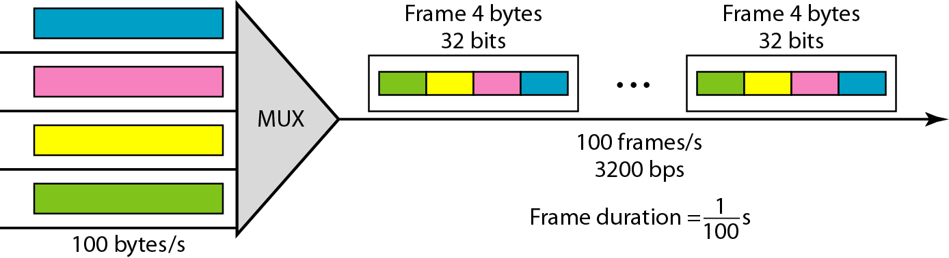
TDM
Example 8: Four channels are multiplexed using TDM. If each channel sends 100 bytes /s and we multiplex 1 byte per channel, show the frame traveling on the link, the size of the frame, the duration of a frame, the frame rate, and the bit rate for the link.
Solution:
Fig. 18: Example 8.
The multiplexer is shown in Figure 18. Each frame carries 1 byte from each channel; the size of each frame, therefore, is 4 bytes, or 32 bits. Because each channel is sending 100 bytes/s and a frame carries 1 byte from each channel, the frame rate must be 100 frames per second. The bit rate is 100 × 32, or 3200 bps.
100 frames =1 second, so 1 frame =1/100 s

Slide 5
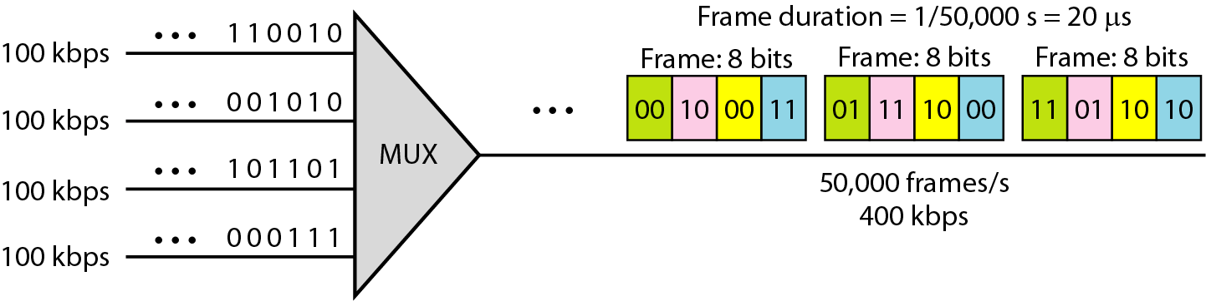
TDM
Example 9:
A multiplexer combines four 100-kbps channels using a time slot of 2 bits. Show the output with four arbitrary inputs. What is the frame rate? What is the frame duration? What is the bit rate? What is the bit duration?
Solution:
Figure 19 shows the output (4x100kbps) for four arbitrary inputs. The link carries 400K/(2x4)=50,000 frames per second [2x4=8bit] . The frame duration is therefore 1/50,000 s or 20 μs. The bit duration on the output link is 1/400,000 s, or 2.5 μs.

Slide 6
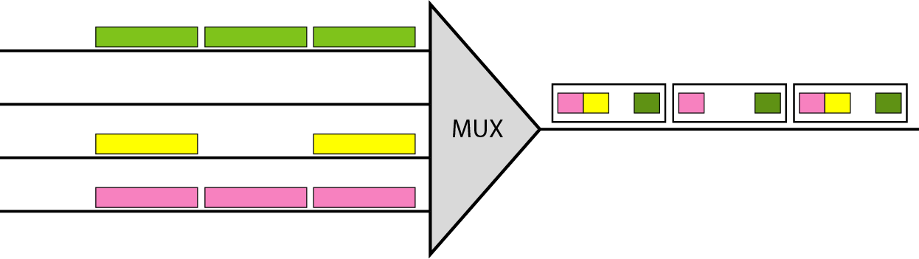
Empty Slot
Sometimes an input link may have no data to transmit.
When that happens, one or more slots on the output link will go unused.
That is wastage of bandwidth.
Statistical TDM can improve the efficiency.
Fig. 20: Empty Slots.

Slide 7
Data Rate Management
Data Rate Management:
Not all input links maybe have the same data rate.
Some links maybe slower. There maybe several different input link speeds.
There are three strategies that can be used to overcome the data rate mismatch: multilevel, multislot and pulse stuffing.
Data rate matching:
Multilevel: used when the data rate of the input links are multiples of each other.
Multislot: used when there is a GCD(Greatest Common Divisor) between the data rates. The higher bit rate channels are allocated more slots per frame, and the output frame rate is a multiple of each input link.
Pulse Stuffing: used when there is no GCD between the links. The slowest speed link will be brought up to the speed of the other links by bit insertion, this is called pulse stuffing.

Slide 8
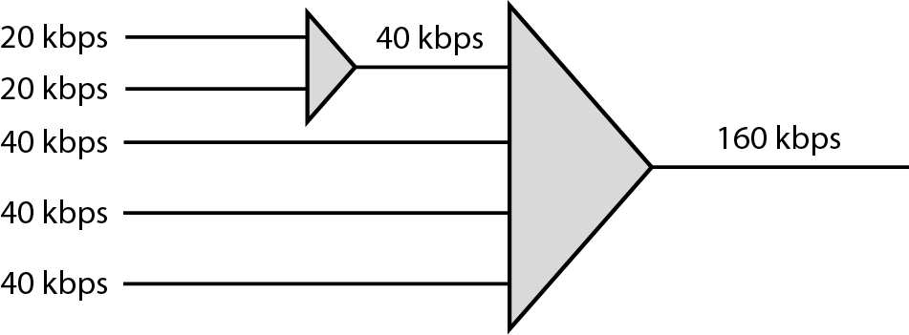
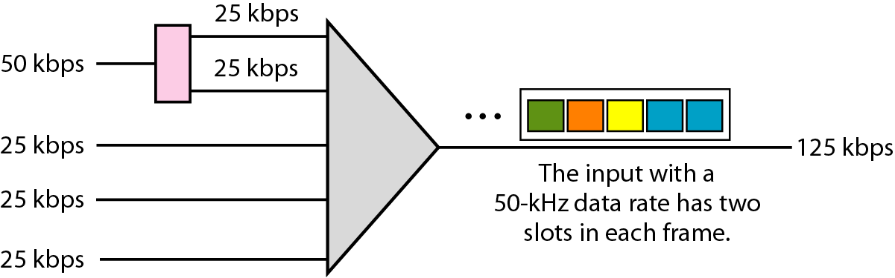
Data Rate Management
Fig. 21: Multilevel Multiplexing.
Fig. 22: Multislot Multiplexing.

Slide 9
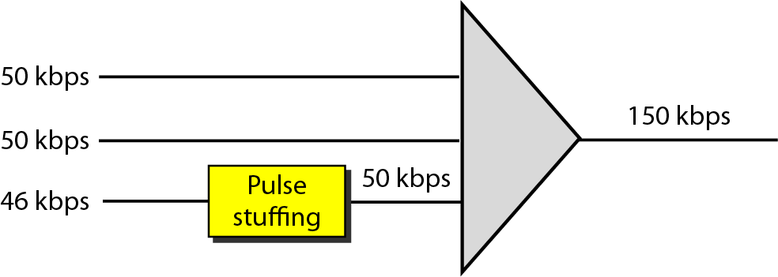
Data Rate Management
Fig. 23: Multislot Multiplexing

Slide 10
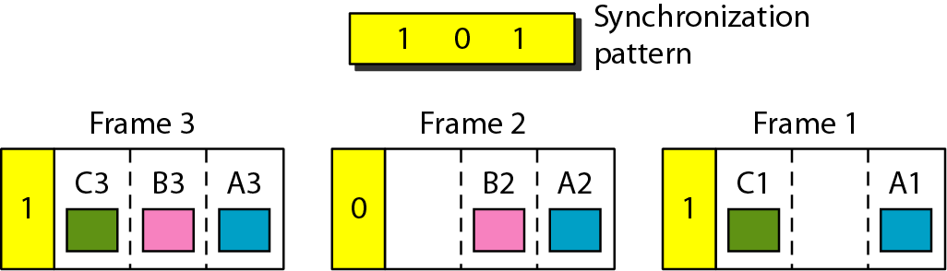
Frame Synchronization
Synchronization between the multiplexer and demultiplexer is a major issue.
If the multiplexer and the demultiplexer are not synchronized, a bit belonging to one channel may be received by the wrong channel.
For this reason, one or more synchronization bits are usually added to the beginning of each frame.
These bits, called framing bits, follow a pattern, frame to frame, that allows the demultiplexer to synchronize with the incoming stream so that it can separate the time slots accurately.
In most cases, this synchronization information consists of 1 bit per frame, alternating between 0 and 1, as shown in Figure 24.
Fig. 24: Multislot Multiplexing.

Slide 11
Mathematical Problem
Example 10:
We have four sources, each creating 250 8-bit characters per second. If the interleaved unit is a character and 1 synchronizing bit is added to each frame, find (a) the data rate of each source, (b) the duration of each character in each source, (c) the frame rate, (d) the duration of each frame, (e) the number of bits in each frame
Solution:
a. The data rate of each source is 250 × 8 = 2000 bps = 2 kbps.
b. Each source sends 250 characters per second; therefore, the duration of a character is 1/250 s, or 4 ms.
c. Frame rate is same as the input source rate, which means the link needs to send 250 frames per second to keep the transmission rate of each source.
d. The duration of each frame is 1/250 s, or 4 ms. Note that the duration of each frame is the same as the duration of each character coming from each source.
e. Each frame carries 4 characters and 1 extra synchronizing bit. This means that each frame is 4 × 8 + 1 = 33 bits.

Slide 12
Mathematical Problem
Example 11:
Two channels, one with a bit rate of 100 kbps and another with a bit rate of 200 kbps, are to be multiplexed. How this can be achieved? What is the frame rate? What is the frame duration? What is the bit rate of the link?
Solution:
We can allocate one slot to the first channel and two slots to the second channel. Each frame carries 3 bits. The frame rate is 100,000 frames per second because it carries 1 bit from the first channel. The bit rate is 100,000 frames/s × 3 bits per frame, or 300 kbps.

Slide 13
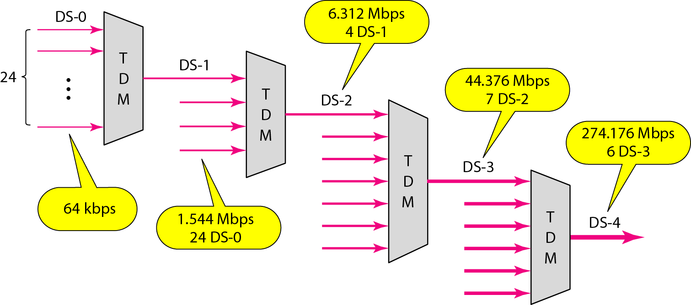
Digital Hierarchy
Digital hierarchy:
Telephone companies implement TDM through a hierarchy of digital signals, called digital signal (DS) service or digital hierarchy. Figure 25 shows the data rates supported by each level.
Fig. 25: Digital Hierarchy.

Slide 14
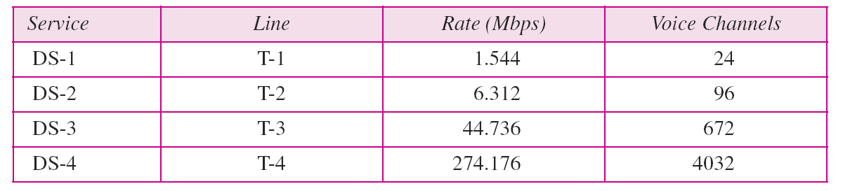
Digital Hierarchy
T Lines:
DS-0, DS-1, and so on are the names of services. To implement those services, the telephone companies use T lines (T-1 to T-4). These are lines with capacities precisely matched to the data rates of the DS-1 to DS-4 services (see Table 1). So far only T-1 and T-3 lines are commercially available.
Table 1

Slide 15
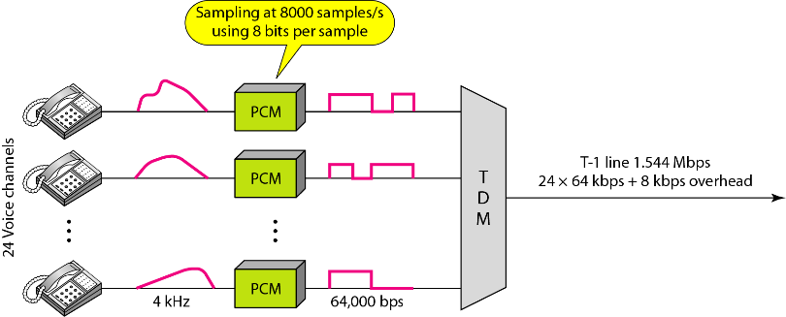
Digital Hierarchy
T Lines for Analog Transmission:
T lines are digital lines designed for the transmission of digital data, audio, or video. However, they also can be used for analog transmission (regular telephone connections), provided the analog signals are first sampled, then time-division multiplexed.
Fig. 26: T-1 line for multiplexing telephone lines.

Slide 16
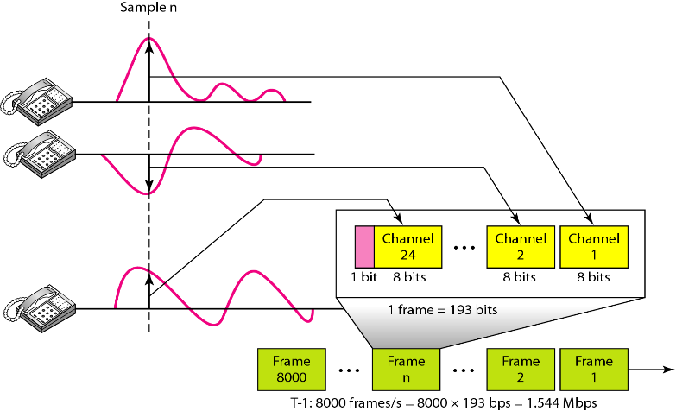
T-1 frame structure
Fig. 27: T-1 Frame Structure.

Slide 17
E line rates:
E line rates:
Europeans use a version of T lines called E lines. The two systems are conceptually identical, but their capacities differ.
Table 2

Slide 18
Statistical Time-Division Multiplexing
In synchronous TDM, each input has a reserved slot in the output frame. This can be inefficient if some input lines have no data to send.
In statistical time-division multiplexing,
Slots are dynamically allocated to improve bandwidth efficiency. Only when an input line has a slot's worth of data to send, then it is given a slot in the output frame.
In statistical multiplexing,
The number of slots in each frame is less than the number of input lines.
1. The multiplexer checks each input line in round robin fashion;
2. it allocates a slot for an input line if the line has data to send; otherwise,
3. it skips the line and checks the next line.

Slide 19
Statistical Time-Division Multiplexing
Addressing:
Figure 28 also shows a major difference between slots in synchronous TDM and statistical TDM. An output slot in synchronous TDM is totally occupied by data;
In statistical TDM, a slot needs to carry data as well as the address of the destination.
In synchronous TDM, there is no need for addressing; synchronization and pre assigned relationships between the inputs and outputs serve as an address. If the multiplexer and the demultiplexer are synchronized, this is guaranteed.
In statistical multiplexing, there is no fixed relationship between the inputs and outputs because there are no pre-assigned or reserved slots.
We need to include the address of the receiver inside each slot to show where it is to be delivered.

Slide 20
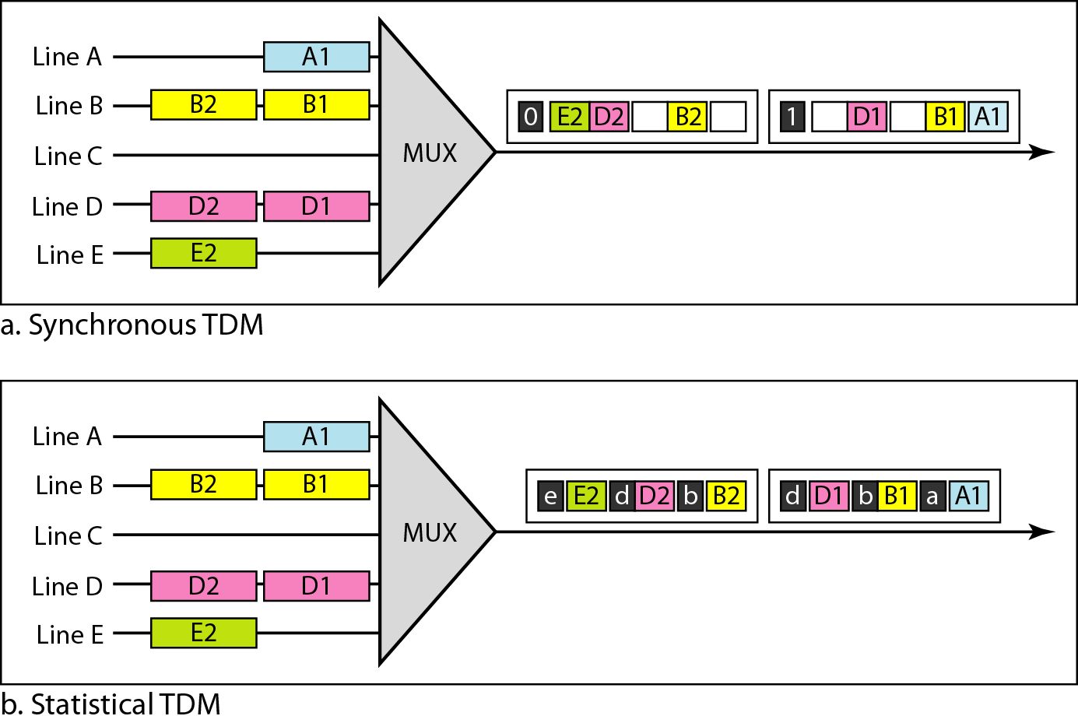
TDM slot comparison
Fig. 28: TDM slot comparison.

Slide 21
Books
1. Forouzan, B. A. "Data Communication and Networking. Tata McGraw." (2005).

Slide 22
References
1. Prakash C. Gupta, “Data communications”, Prentice Hall India Pvt.
2. William Stallings, "Data and Computer Communications”, Pearson
3. Forouzan, B. A. "Data Communication and Networking. Tata McGraw." (2005).

